Slide 1
CS 726 Project Report
A Comparison of Batch Normalization and Group Normalization
Team Name : abnormal
Members : Chinmay (15D070046)
Saqib (150070031)
Srivatsan (150070005)

Slide 2
Problem Statement
Batch normalization (BN) widely used in neural networks
Reason why BN works well is not clearly understood
Newly proposed group normalization (GN) shown to work better
We aim to :-
Compare the performance of BN and GN experimentally
Evaluate the performance for different batch sizes and group sizes
Provide a theoretical analysis of GN, on similar lines to BN
Understand how different groupings affect the performance of GN

Slide 3
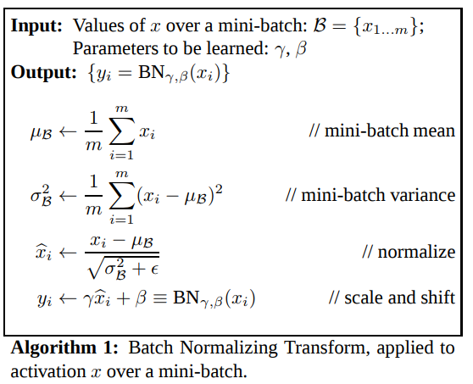
Literature Study
Batch Normalization [Ioffe, Szegedy, 2015]
Widely used in training deep neural networks
Makes optimization faster by allowing larger training rates
Originally claimed to work by reducing “internal covariate shift”

Slide 4
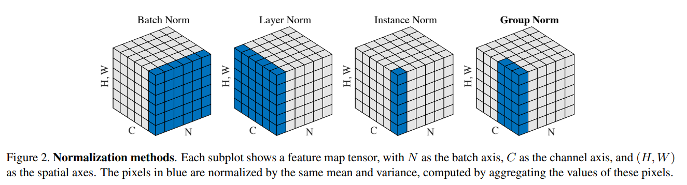
Literature Study
Group Normalization [Wu, He (Facebook AI Research), 2018]
Shown to give better results on image classification, segmentation
Works better than BN while using smaller mini-batches

Slide 5


Literature Study
Theoretical Analysis
Ioffe, Szegedy claim that BN reduces “internal covariate shift” (ICS)
Santurkar et. al. [2018] show that BN does not reduce ICS in general
However, BN makes the gradient more Lipschitz and more predictable
Thus, BN helps training by “smoothening the optimization landscape”

Slide 6
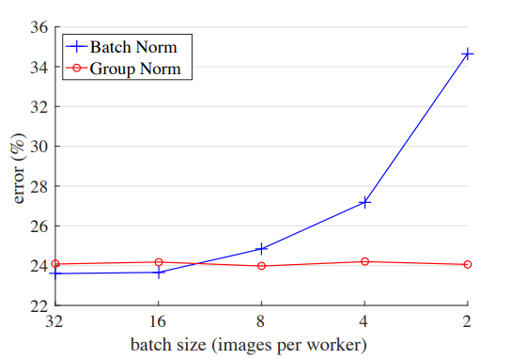
Literature Study
Gaps in previous work
The reasons behind the success of BN remain unclear
While GN has shown good results, its theoretical analysis is missing
Comparison of BN and GN for varying group sizes is not done

Slide 7
Experiment Setup
Nature of Experiments
Compare performance of BN and GN for image classification tasks
Evaluate the performance for different group and batch sizes
Visualize the effects of BN and GN on the distributions
Coding resources : Tensorflow on Google Colab
Datasets : MNIST and CIFAR10

Slide 8
Experiment Setup
Network Architecture
Convolutional layer with 16 filters of size 3x3
2x2 Max-pooling layer
Convolutional layer with 32 filters of size 3x3
2x2 Max-pooling layer
Fully connected layer with 256 hidden units
Fully connected layer with softmax to generate 10 probabilities
Batch/Group norm after each convolutional layer, before its ReLU non-linearity.

Slide 9
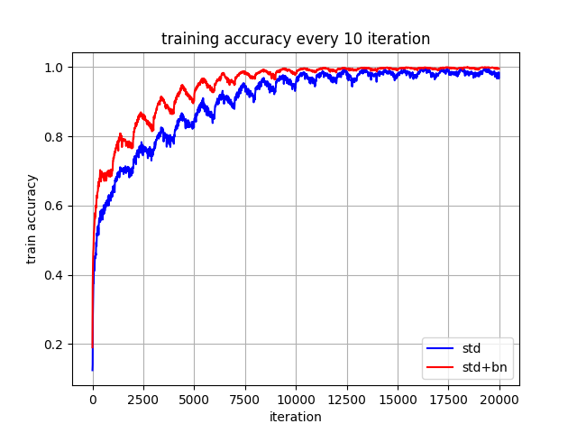
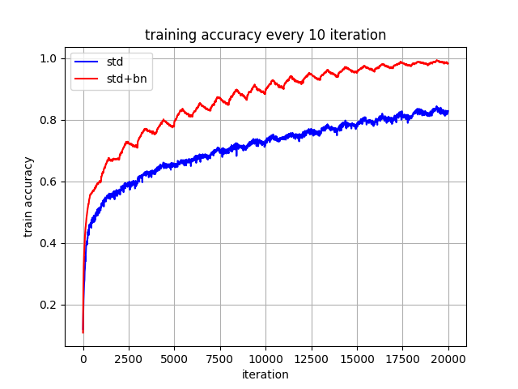
Effect of learning rate on training accuracy for standard and standard+BN
BS : 50, ES : 20, LR : 1e-3 BS : 50, ES : 20, LR : 1e-4

Slide 10
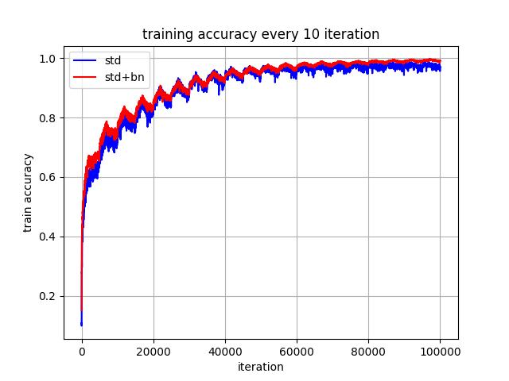
Effect of batch size on training accuracy for standard and standard+BN
BS : 50, ES : 20, LR : 1e-3 BS : 10, ES : 20, LR : 1e-3

Slide 11
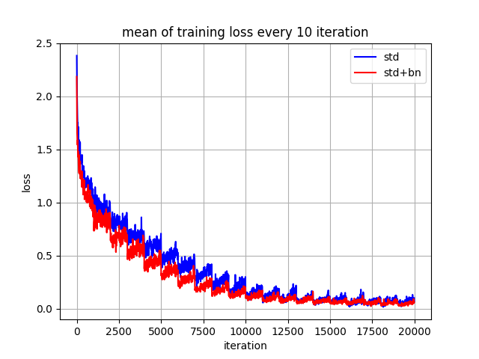
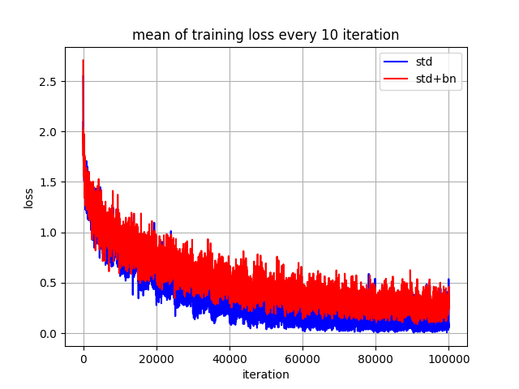
Effect of batch size on training loss for standard and standard+BN
BS : 50, ES : 20, LR : 1e-3 BS : 10, ES : 20, LR : 1e-3

Slide 12
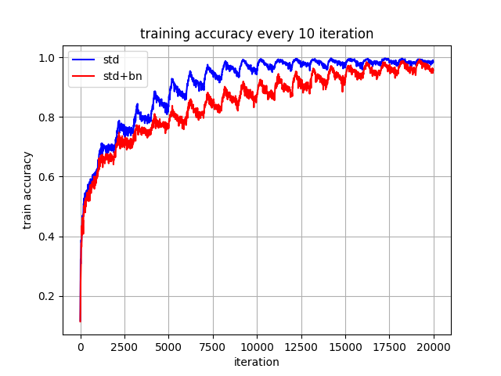
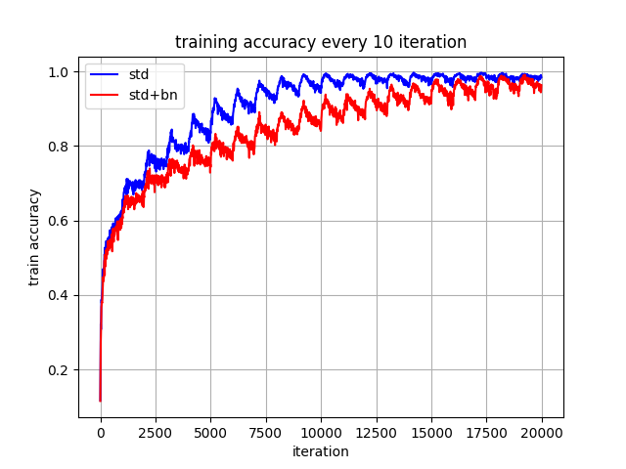
Not much effect of number groups on training accuracy for standard and standard+GN
BS : 50, ES : 20, LR : 1e-3, GS : 1 BS : 50, ES : 20, LR : 1e-3, GS : 4

Slide 13
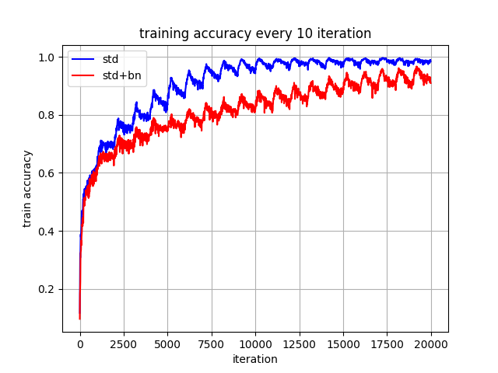
Group Norm seems to achieve lower training accuracy compared to standard. It may be conjectured
that group sizes are very small here compared to that in large CNNs similar to batch size in BN.
BS : 50, ES : 20, LR : 1e-3, GS : 1 BS : 50, ES : 20, LR : 1e-3, GS : 16

Slide 14
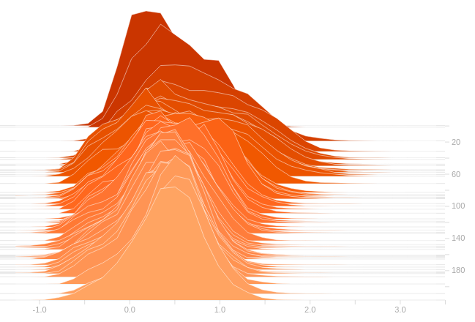
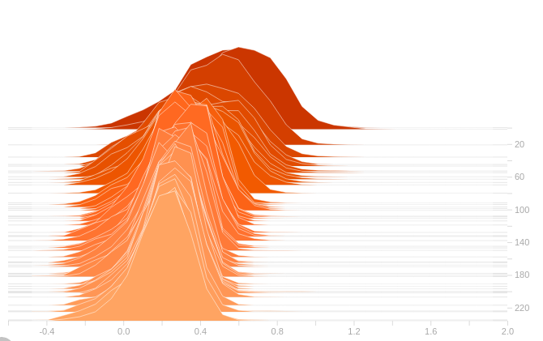
Visualizations
Histogram of the output of a selected channel versus time
Normalization makes the distributions more regular

Slide 15
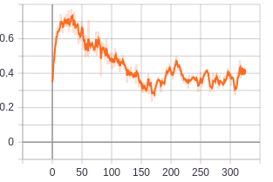
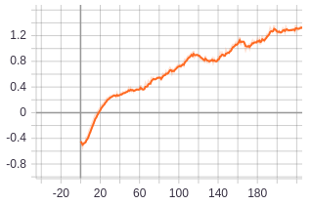
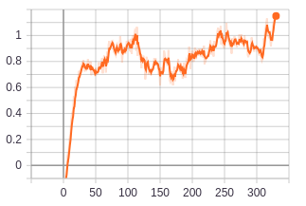
Visualizations
Mean of the output of few selected channels versus time
Channels with similar distributions expected to benefit from GN

Slide 16
Visualizations
Mean of the output of few selected channels versus time
Channels with similar distributions expected to benefit from GN

Slide 17
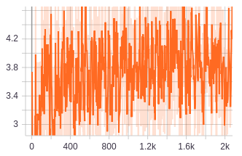
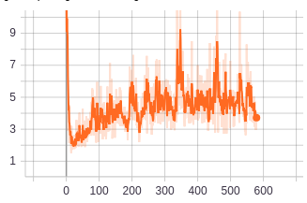
Visualizations
Variation of L-2 Norm of the Gradient with time
In this case, gradients are more constrained when GN is absent

Slide 18
Conclusion
Future Work
Project provided a basic comparison of both methods
Developed a good theoretical understanding, and intuition for BN and GN
GN did not work well in this project, possibly due to small group size
Understanding of why normalization improves training
Theoretical analysis of GN in a similar manner to BN
Analysis of GN for larger groups using larger CNNs
Dynamically creating groups based on channel correlations

Slide 19
References
S. Ioffe and C. Szegedy. Batch Normalization: Accelerating Deep Network Training b y Reducing Internal Covariate Shift. arXiv 1502.03167, 2018.
S. Santurkar, D. Tsipras, A. Ilyas, A. Madry. How Does Batch Normalization Help Optimization? NeurIPS 2018.
Y. Wu, K. He. Group Normalization. arXiv 1803.08494, 2018.

